Slide 1
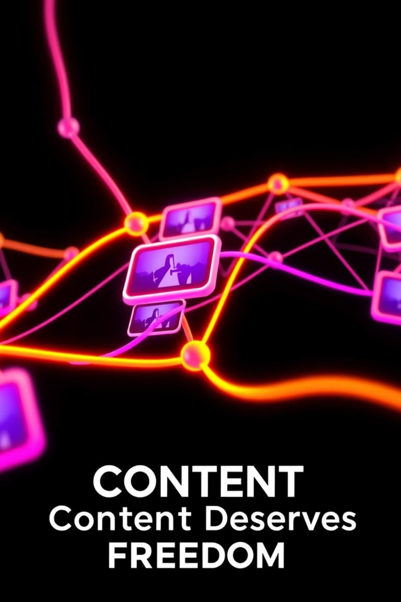
Video-Hub: Decentralized Video Streaming with Blockchain Security
Transforming the future of online video.

Slide 2


Agenda: Pioneering Decentralized Video
Introduction to VideoHub
Addressing Centralisation Issues
Our Innovative Solution
Understanding the core concept and its necessity in today's digital landscape.
Highlighting the critical problems with current centralised video platforms.
Exploring VideoHub's unique approach with blockchain and canister technology.
Key Features & Technical Deep Dive
Benefits & Future Vision
Delving into the functionalities and underlying architecture that power VideoHub.
Showcasing the advantages and outlining the exciting future developments for the platform.

Slide 3

Introduction to VideoHub: The Future of Content
VideoHub is a pioneering decentralized video streaming platform, designed to offer a robust and user-centric alternative to existing centralized services like YouTube. We empower creators and viewers by leveraging cutting-edge blockchain technology and canister-based storage.
In an era demanding greater control over digital assets and freedom of expression, VideoHub emerges as a crucial solution, ensuring content immutability, enhanced security, and true decentralization. We are building a platform where content thrives without single-point vulnerabilities or censorship.

Slide 4






The Centralisation Predicament: Why VideoHub is Essential
Centralised Control
Censorship & Deplatforming
Existing platforms operate on centralized servers, granting immense power to a single entity over content distribution and user data. This leads to arbitrary policy changes and content manipulation.
Content creators face the constant threat of censorship or deplatforming without clear, immutable guidelines. This stifles free speech and limits diverse perspectives.
Security Vulnerabilities
Unfair Monetization
Centralised databases are prime targets for cyber-attacks, risking user data breaches and service outages. Trust is eroded when personal information is compromised.
Creators often receive an inequitable share of revenue, with platforms retaining a disproportionate amount. Transparency in monetization models is severely lacking.

Slide 5
Beyond the Status Quo: Analysing Existing Solutions
While some platforms attempt decentralization, they often fall short in critical areas, failing to provide a truly robust and immutable video ecosystem.
YouTube
Massive user base, established monetization, extensive content library.
Highly centralised, severe censorship issues, opaque revenue sharing, data vulnerability.
Vimeo
High-quality content, professional community, customizable players.
Centralised storage, lower reach, subscription-based upload limits, limited decentralised features.
DTube
Early adopter of blockchain, incentivised content creation, censorship-resistant.
Scalability challenges, smaller user base, UI/UX can be clunky, reliance on specific blockchain.
VideoHub directly addresses these weaknesses by integrating full blockchain immutability and highly scalable canister storage, providing a next-generation solution.

Slide 6



Our Solution: VideoHub's Decentralized Architecture
Blockchain Immutability
Canister-Based Storage
Transparent Operations
All video metadata and content hashes are securely recorded on a public blockchain. This ensures that once content is published, its record cannot be altered or removed, guaranteeing content integrity and provenance.
Video files are stored on decentralized "canisters" within the Internet Computer Protocol (ICP) blockchain. Canisters are smart contracts that can serve web content, offering enhanced security, efficiency, and resistance to single points of failure, unlike traditional servers.
Every interaction, from content uploads to viewing metrics and monetization, is transparently recorded on the blockchain. This fosters trust and provides verifiable data for all participants.

Slide 7





Key Features: Empowering Creators and Viewers
Decentralized Storage
Content Immutability
Smart Contract Monetization
Content hosted across a distributed network, eliminating single points of failure and ensuring resilient access.
Blockchain records prevent unauthorized alterations or deletions of uploaded videos and metadata.
Automated, transparent payments to creators based on viewing metrics, subscriptions, and tips via smart contracts.
Token Rewards
NFT Integration
Viewers and creators earn platform tokens for engagement, fostering a vibrant and active community.
Unique video clips or special content can be tokenized as NFTs, allowing creators to sell exclusive ownership to fans.

Slide 8

Technology Stack: The Backbone of VideoHub
Frontend: React.js - For a dynamic, responsive, and intuitive user interface.
Backend (API/Orchestration): Node.js - Efficient and scalable server-side operations for seamless interaction.
Blockchain: Internet Computer Protocol (ICP) - Provides the decentralized computational power and network for smart contracts and canister storage.
Decentralized Storage: Canisters (on ICP) - Secure, immutable, and scalable storage for video content.
Database: MongoDB - For flexible and scalable data management (primarily for indexing and search, not core content).
This robust stack ensures a high-performance, secure, and truly decentralized video streaming experience.

Slide 9
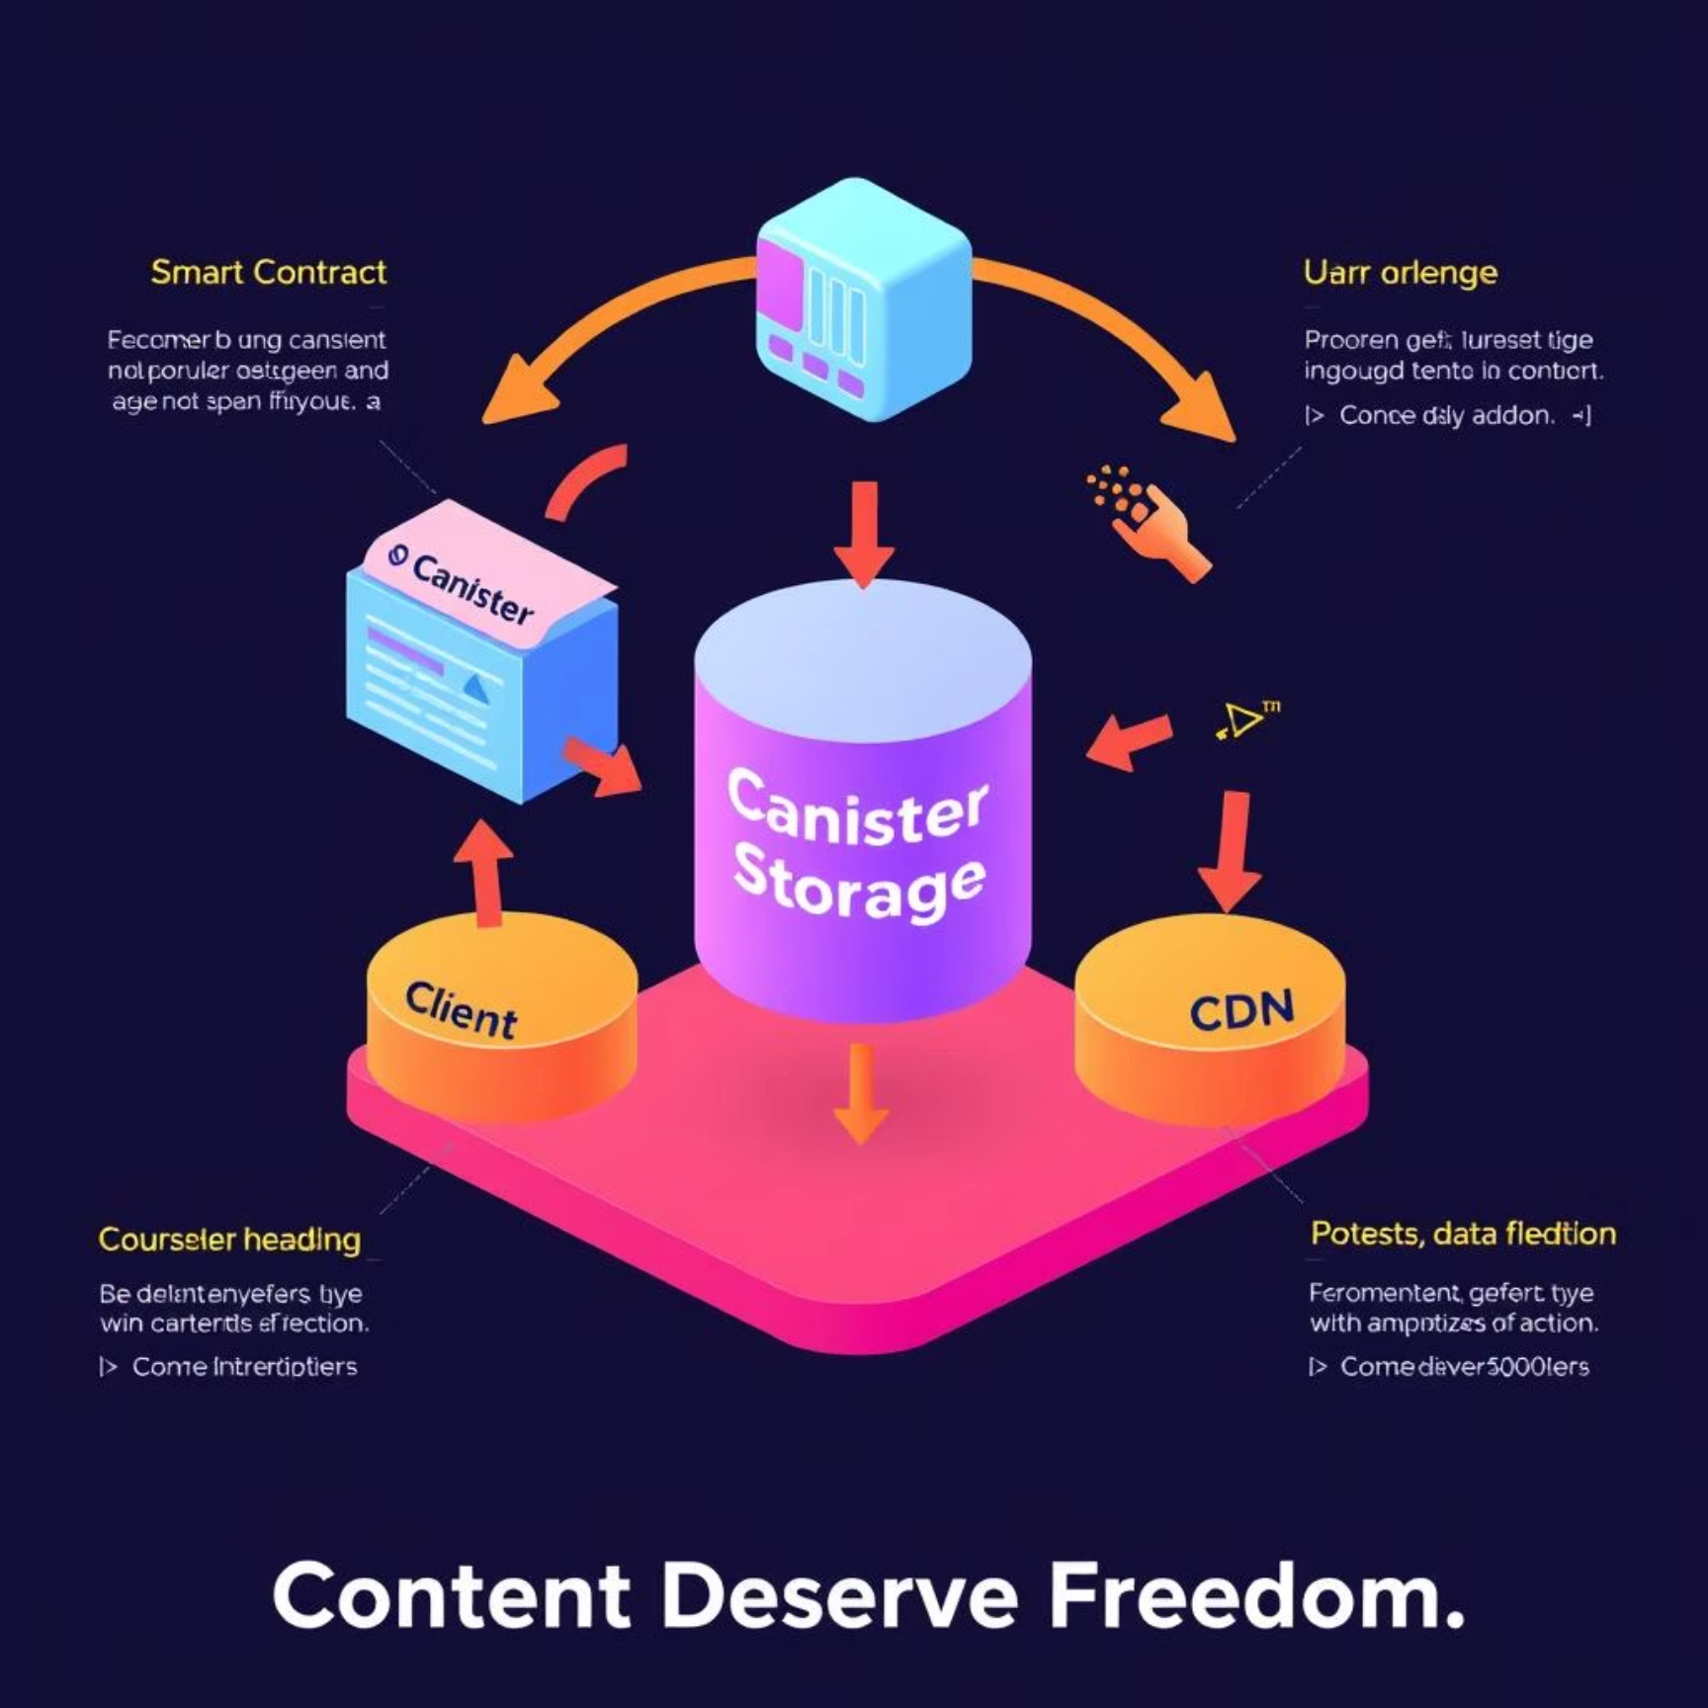
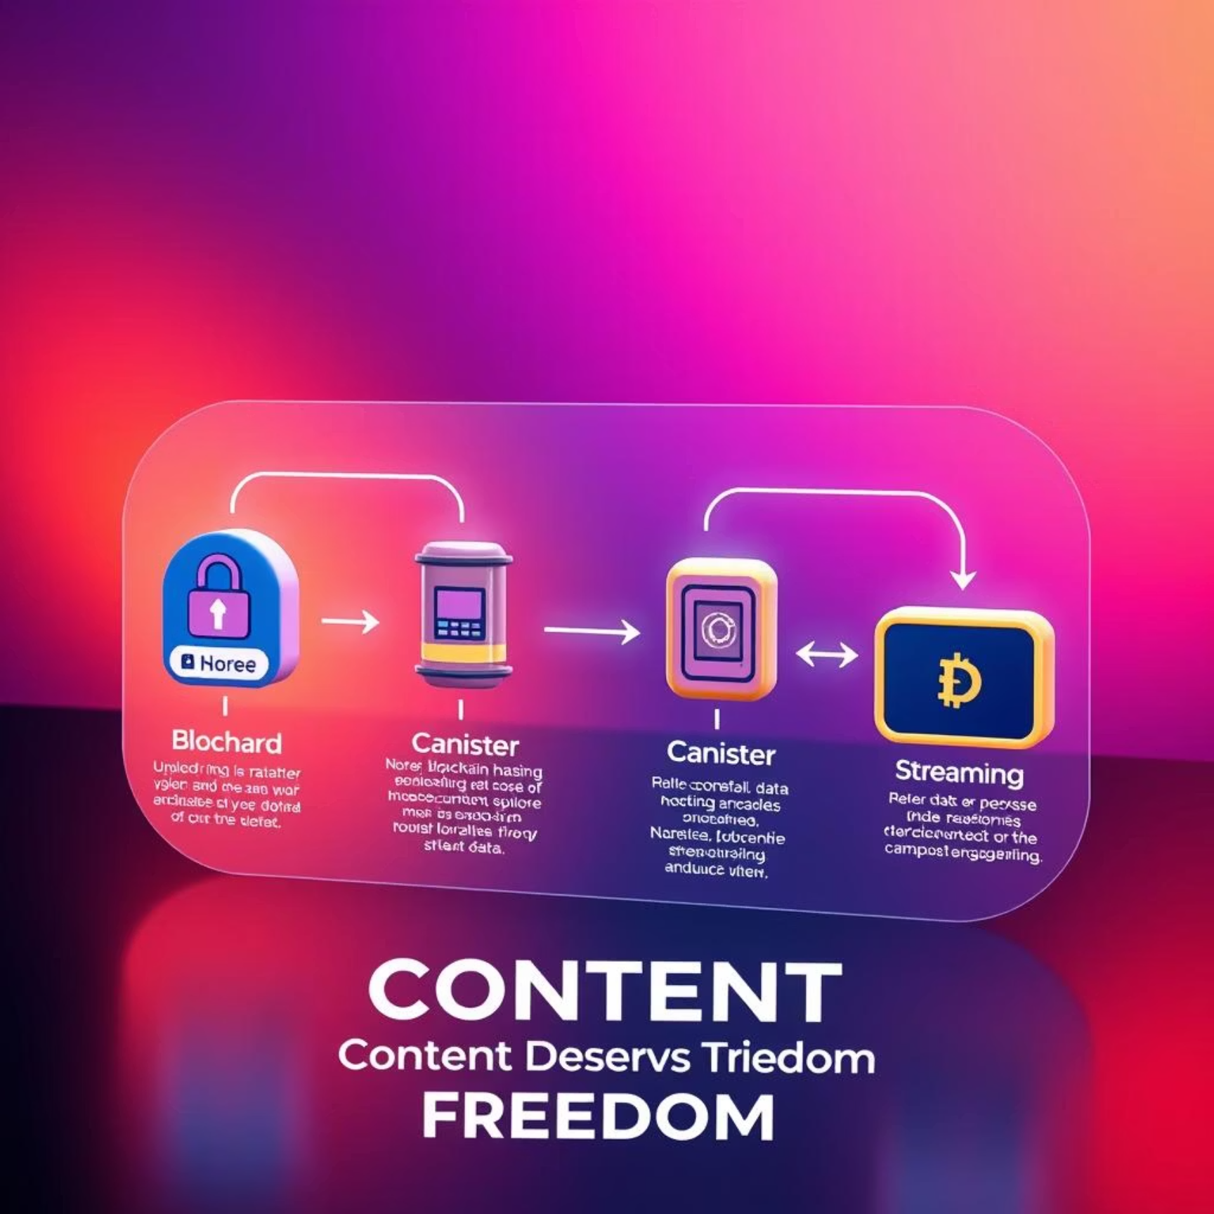
System Architecture & Workflow: How VideoHub Operates
System Architecture Diagram
Content Workflow Diagram
Client interacts with Smart Contract (on Blockchain) for content access. Videos retrieved from Canister Storage via CDN for efficient streaming.
Upload initiates, content undergoes Blockchain Hashing for immutability, stored in Canister Storage, then available for Video Streaming.

